Slide 1
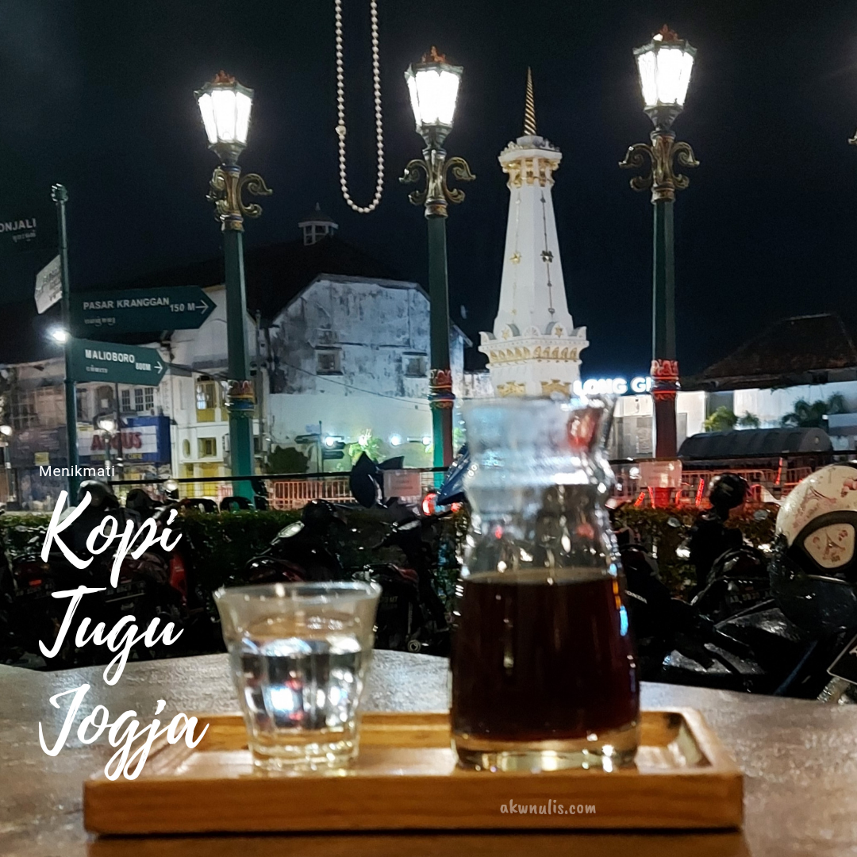
“Caffeine Boost” : Improving Product Sales through Segmentation Strategies of Special Attention Customer at Coffee Shops

Slide 2

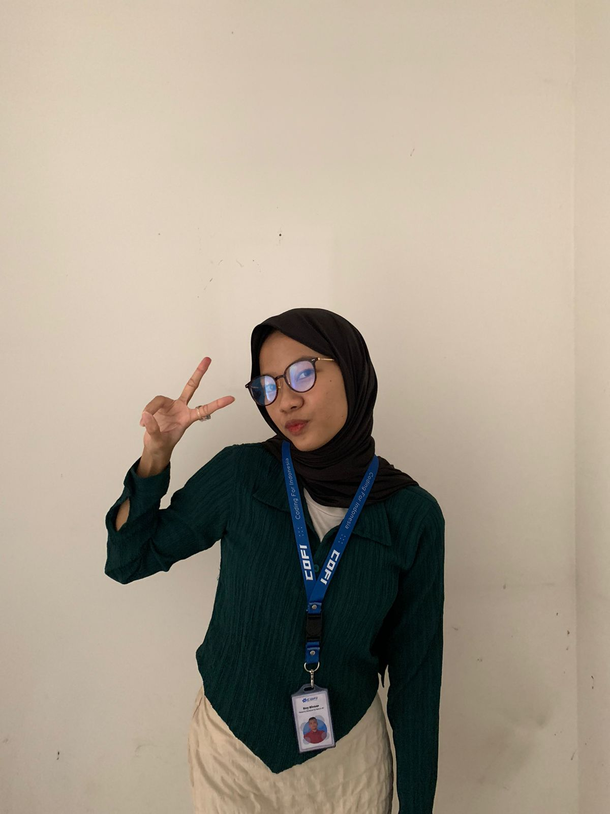


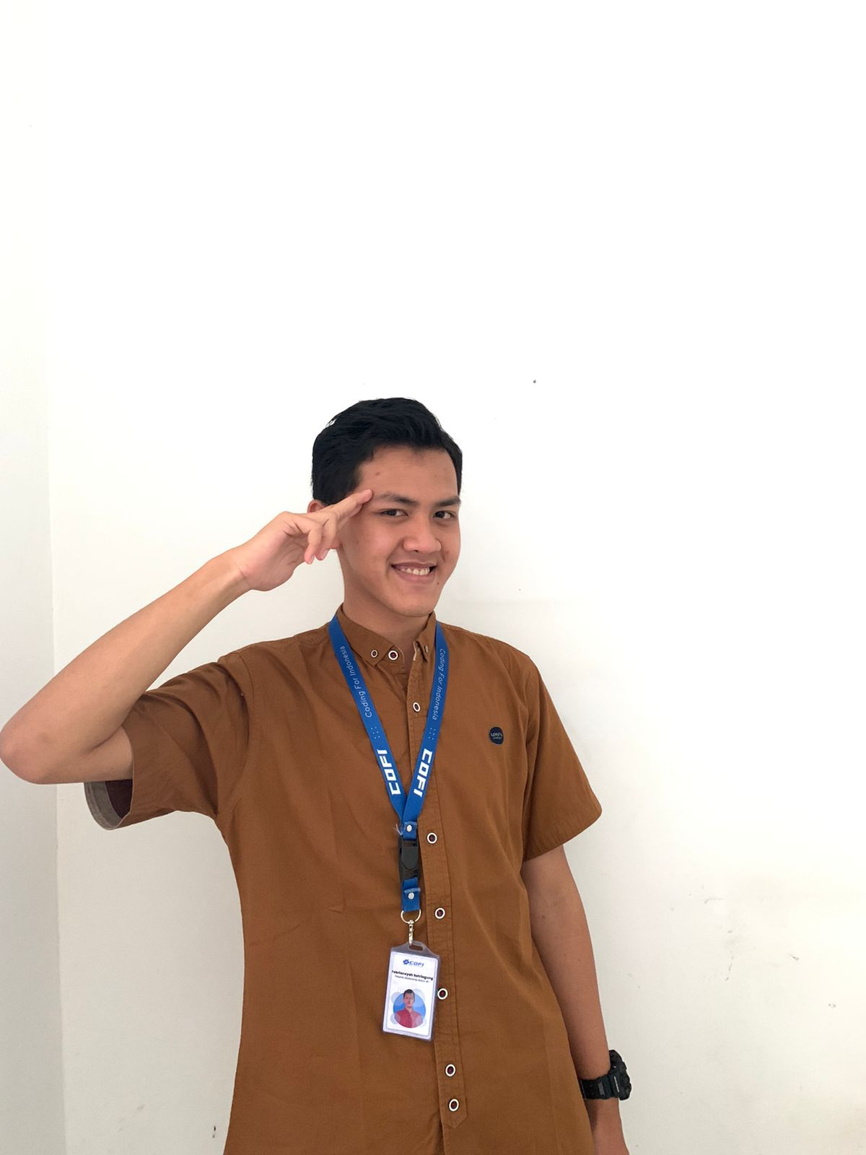
OUR TEAM
Kevin
Shaltsa
Roy
Evan
Febri

Slide 3

Presentation Outline
01
02
03
04
05
Background and Objective
Data Preprocessing
Exploratory Data Analysis
Model
Conclusion

Slide 4
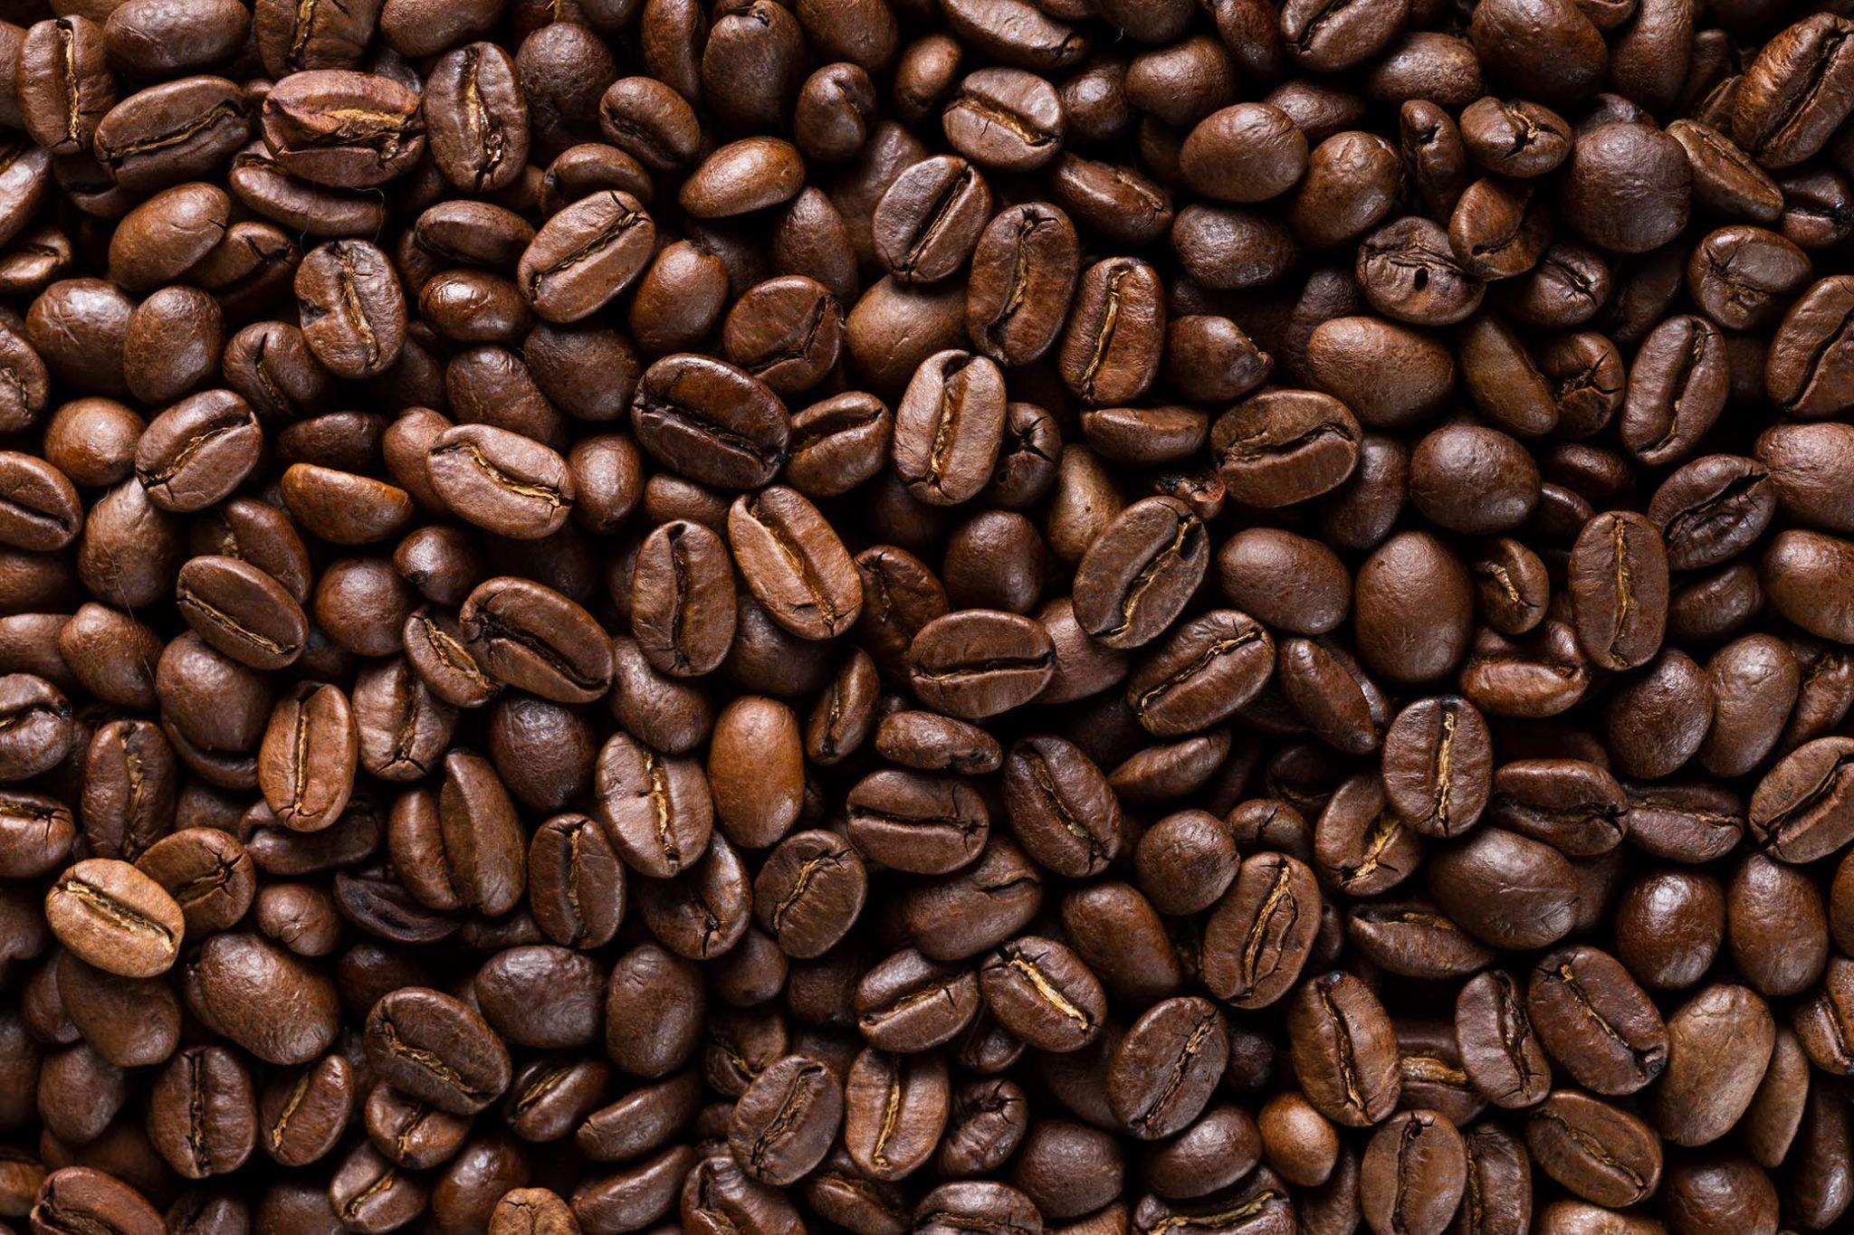
01
BACKGROUND AND OBJECTIVE

Slide 5
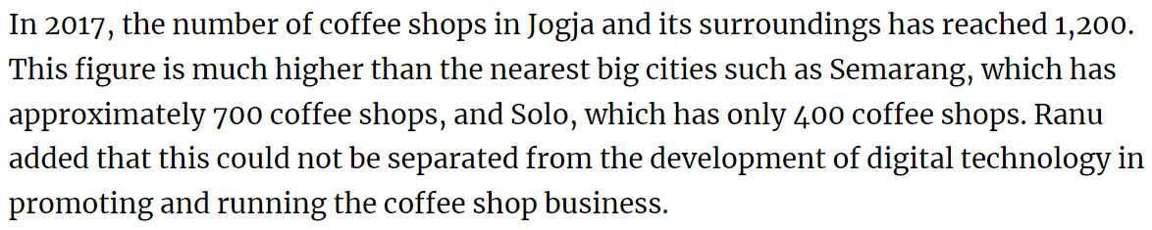
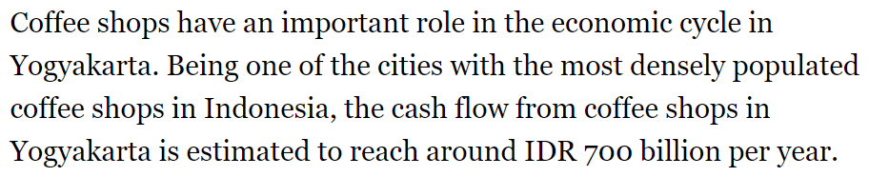
BACKGROUND
SOURCE:https://jogjapolitan.harianjogja.com/read/2018/03/03/510/899467/penasaran-berapa-jumlah-kedai-kopi-di-jogja

Slide 6
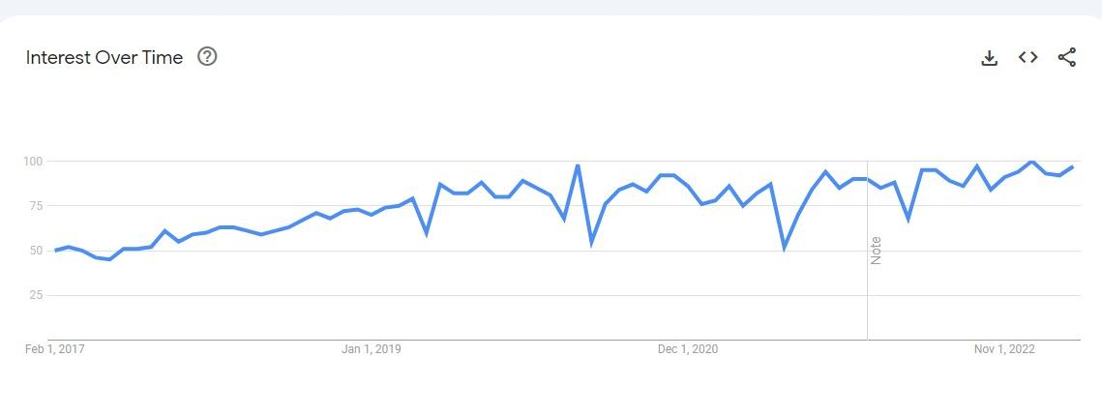
BACKGROUND
Result of Coffee Google Trend

Slide 7
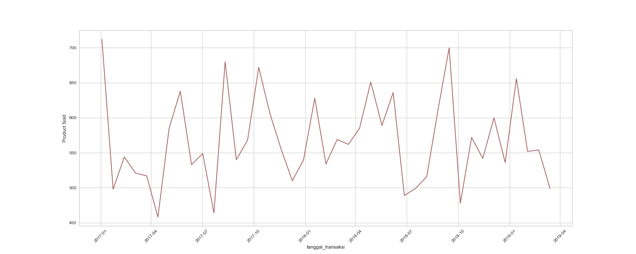
BACKGROUND
Our Growth
Assumption
Seen UP and DOWN /unstable trend sales

Slide 8
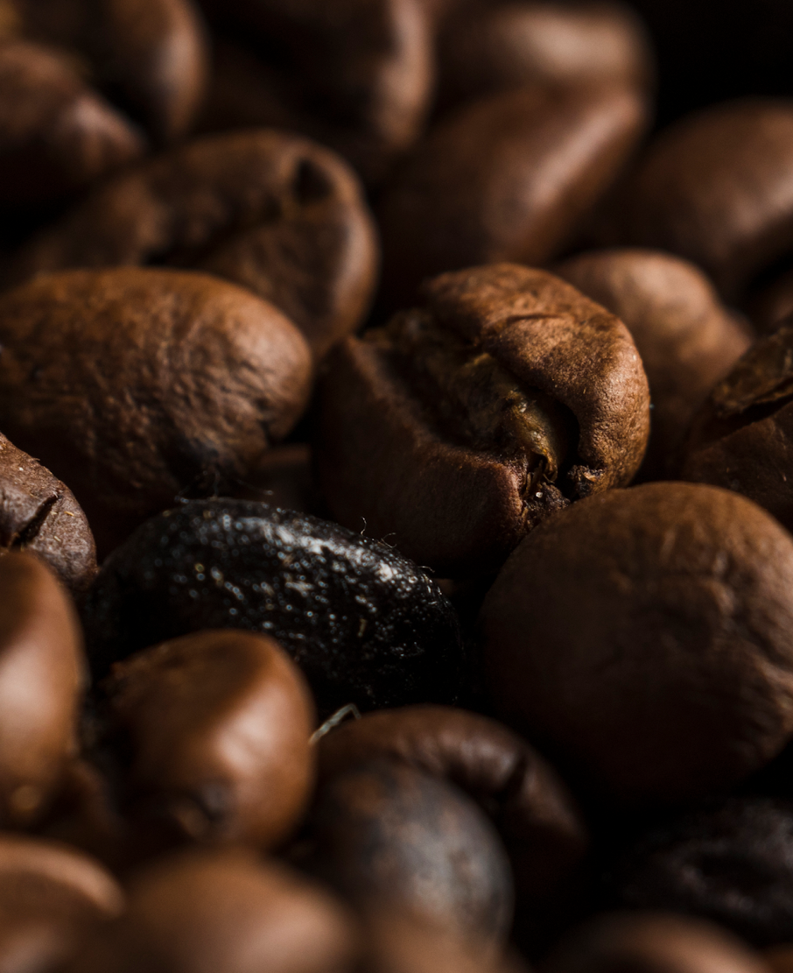
Problem Statement
“How the clustering method identified customer groups that require special attention in order to improve product sales at Coffee shop ?”
CO
FF
EE
Goals
“Understand behavior of customer groups in order to give recommendation for Marketing Team regarding Customers who require attention“

Slide 9
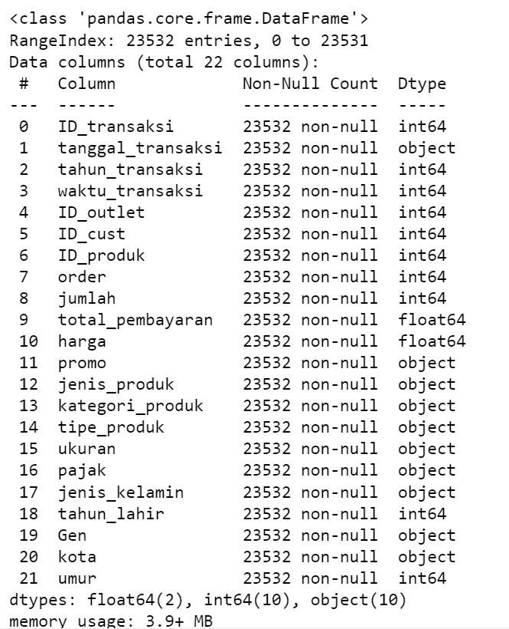
DATASET INFORMATION
23532 Rows
22 Features
ID Transaksi
Tanggal Transaksi
Tahun Transaksi
Waktu Transaksi
ID Outlet
ID Customer
ID Produk
Order
Jumlah
Total Pembayaran
Harga
Promo
Jenis Produk
Kategori Produk
Tipe Produk
Ukuran
Pajak
Jenis Kelamin
Tahun Lahir
Gen
Kota
Umur

Slide 10
02
DATA PREPROCESSING

Slide 11
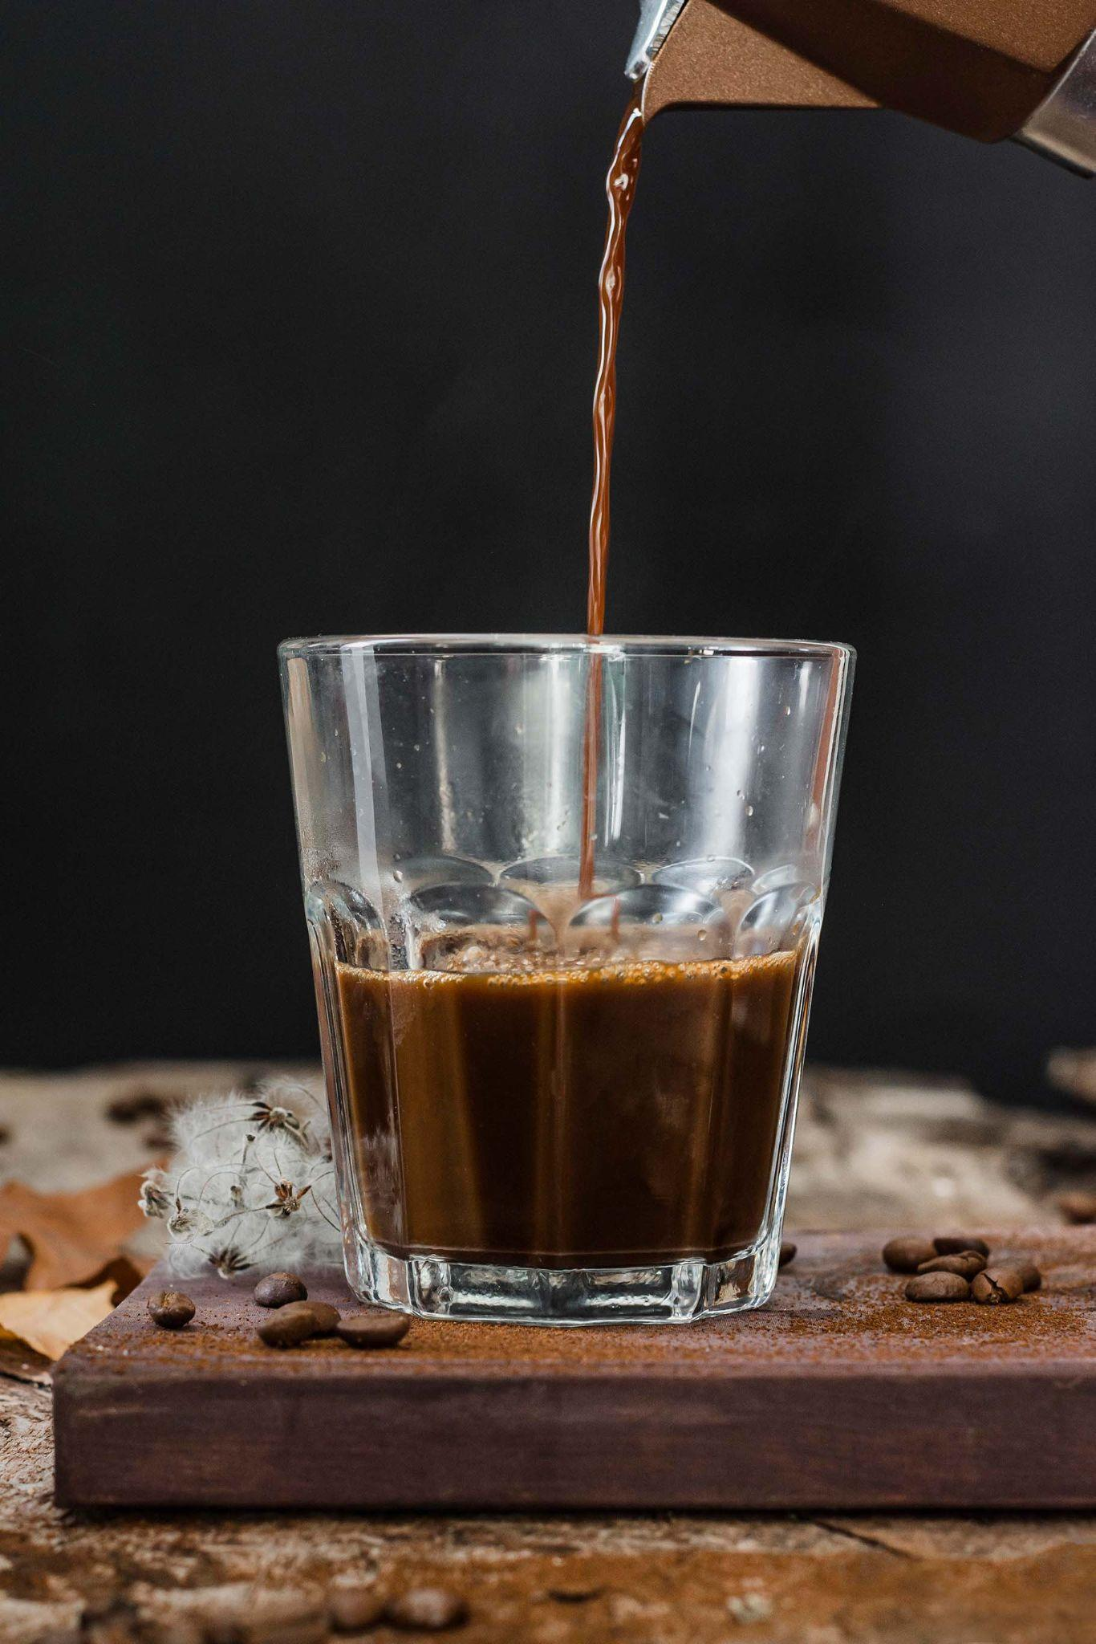
DUPLICATED VALUES
163 Duplicated Values

Slide 12
VALUE RENAME

Slide 13
 | Before | After
Jenis Kelamin | Pria | 0
 | Wanita | 1
Jenis Produk | Minuman | 0
 | Makanan | 1
 | Biji Kopi/Teh | 2
Kategori Produk | Tea | 0
 | Coffee | 1
 | Minuman Coklat | 2
 | Bakery | 3
 | Biji Kopi | 4
 | Leaf Tea | 5
 | Chocolate Boxes | 6
 | Before | After
Promo | Ya | 0
 | Tidak | 1
Pajak | Ya | 0
 | Tidak | 1
Gen | Milennial | 0
 | Gen Z | 1
 | Gen X | 2
Ukuran | Large Size | 0
 | Medium Size | 1
 | Small Size | 2
 | Single | 3
 | 500 Gram | 4
 | 2.5 Kg | 5

Slide 14
03
EXPLORATORY DATA ANALYSIS

Slide 15
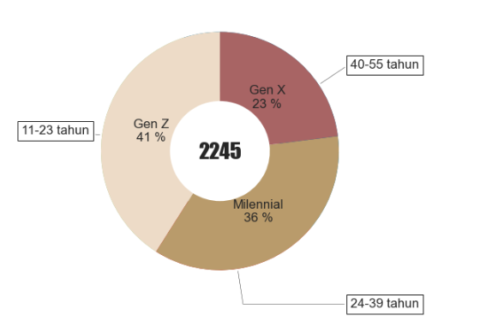
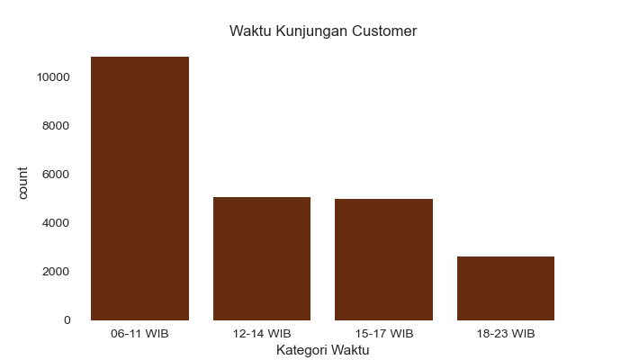
CUSTOMER PROFILE
Gen
Gen Z
Millennial
Gen X
Gen Z is more dominant than others

Slide 16
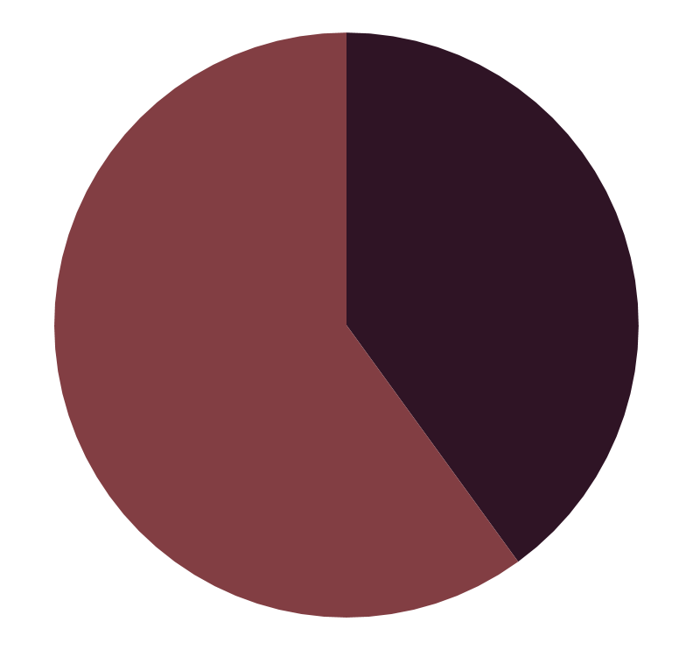
CUSTOMER PROFILE
Gender
Category :
Minuman
44%
82.55%
Makanan
56%
15.73%
Men
Women
Biji kopi/teh
Men customers are more dominant than women
1.72%

Slide 17
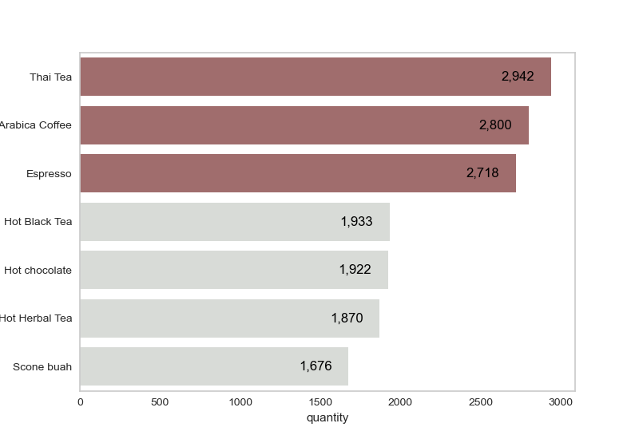
Customer Favorite Product

Slide 18
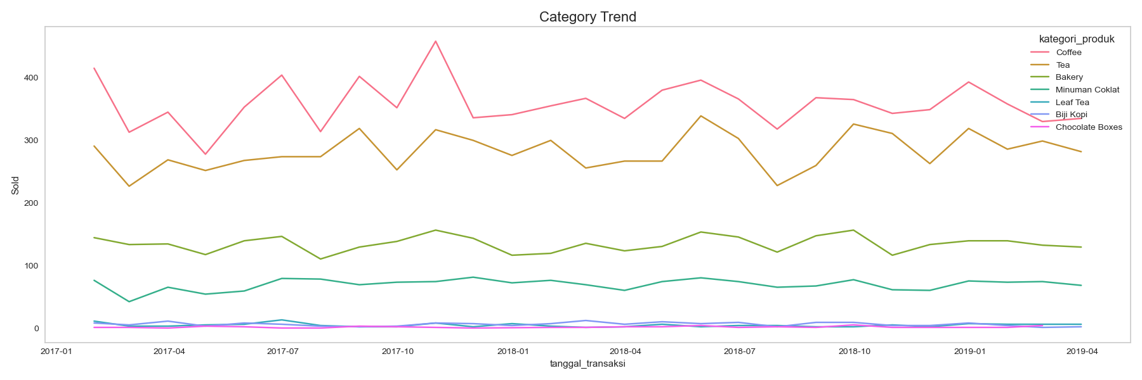
Product Category Trend

Slide 19
04
MODEL

Slide 20
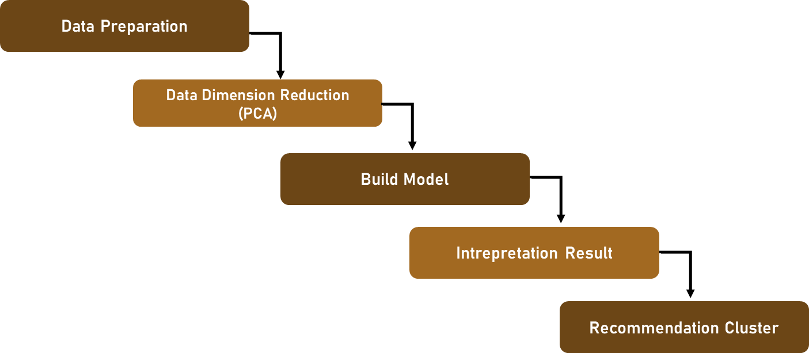
Flow Of Modeling
PCA Component 7
Encoding and Scaling
K-Means 3 Clusters
Impulsive Customer
Customer Need Attention
Loyal Customer

Slide 21
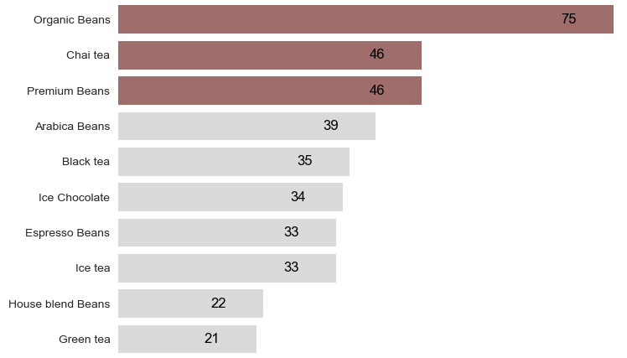
Impulsive Customer
Favorite ID
Outlet: 8
Product Size:
500 gr, Medium
Dominant
Order: 7
Single: 304
Total
Customer:
340

Slide 22
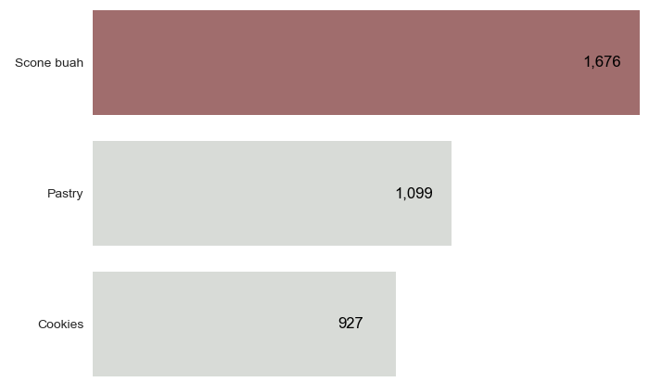
Customer Need Attention
Favorite ID Outlet: 5
Product Size:
Single
Dominant
Order: 1
Single: 694
Total
Customer:
1790

Slide 23
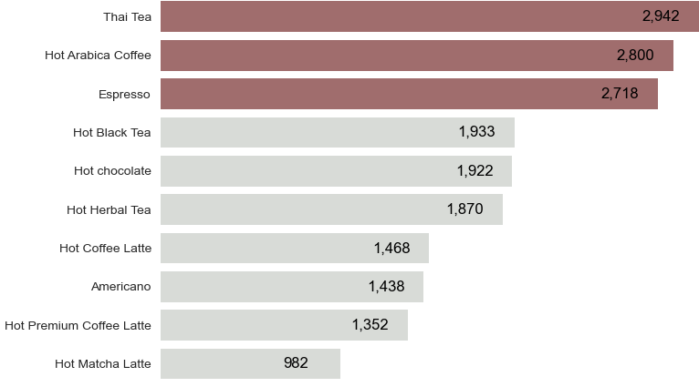
Loyal Customer
Favorite ID Outlet: 3
Product Size:
Large Size
Dominant
Order: 1
Single: 11
Total
Customer:
2245

Slide 24
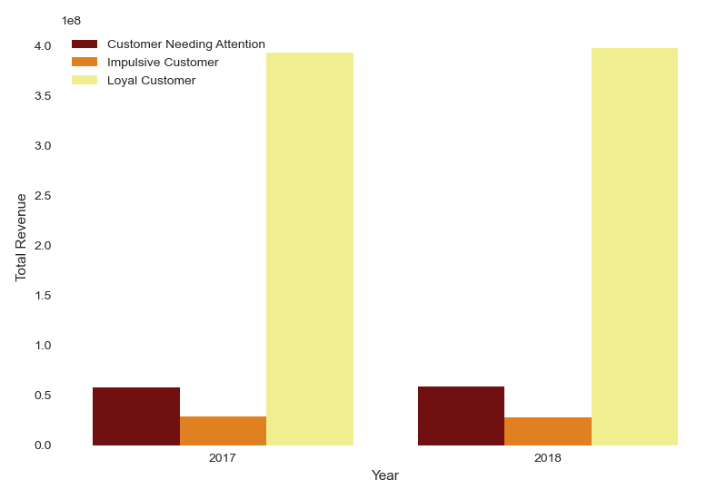
Revenue:
899,939,500 IDR
Impulsive Customer
Revenue:
62.802.500 IDR
Customer need Attention
Revenue: 133.418.200 IDR
Loyal Customer

Slide 25
05
CONCLUSION

Slide 26
Conclusion :
Based on the clustering results, three groups of customers were obtained: Impulsive Customers, Customers Needing Attention, and Loyal Customers. The Customer Needing Attention group has the largest number of customers who make a single order and tend to purchase more food products. They also have the second-highest total revenue and number of customers. Therefore, they have more potential to improve product sales in 2023.

Slide 27
06
RECOMMENDATION

Slide 28
Recommendation :
The Coffee Shop could try to offer products with a product combination package system to “Customer need attention” group where each purchase of food is combined with one of a beverage products in one purchase.

Slide 29

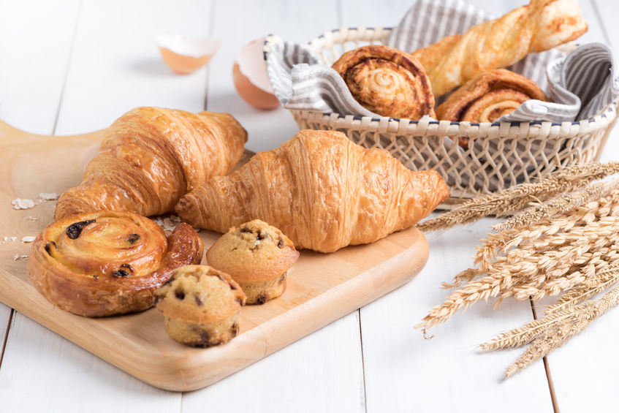

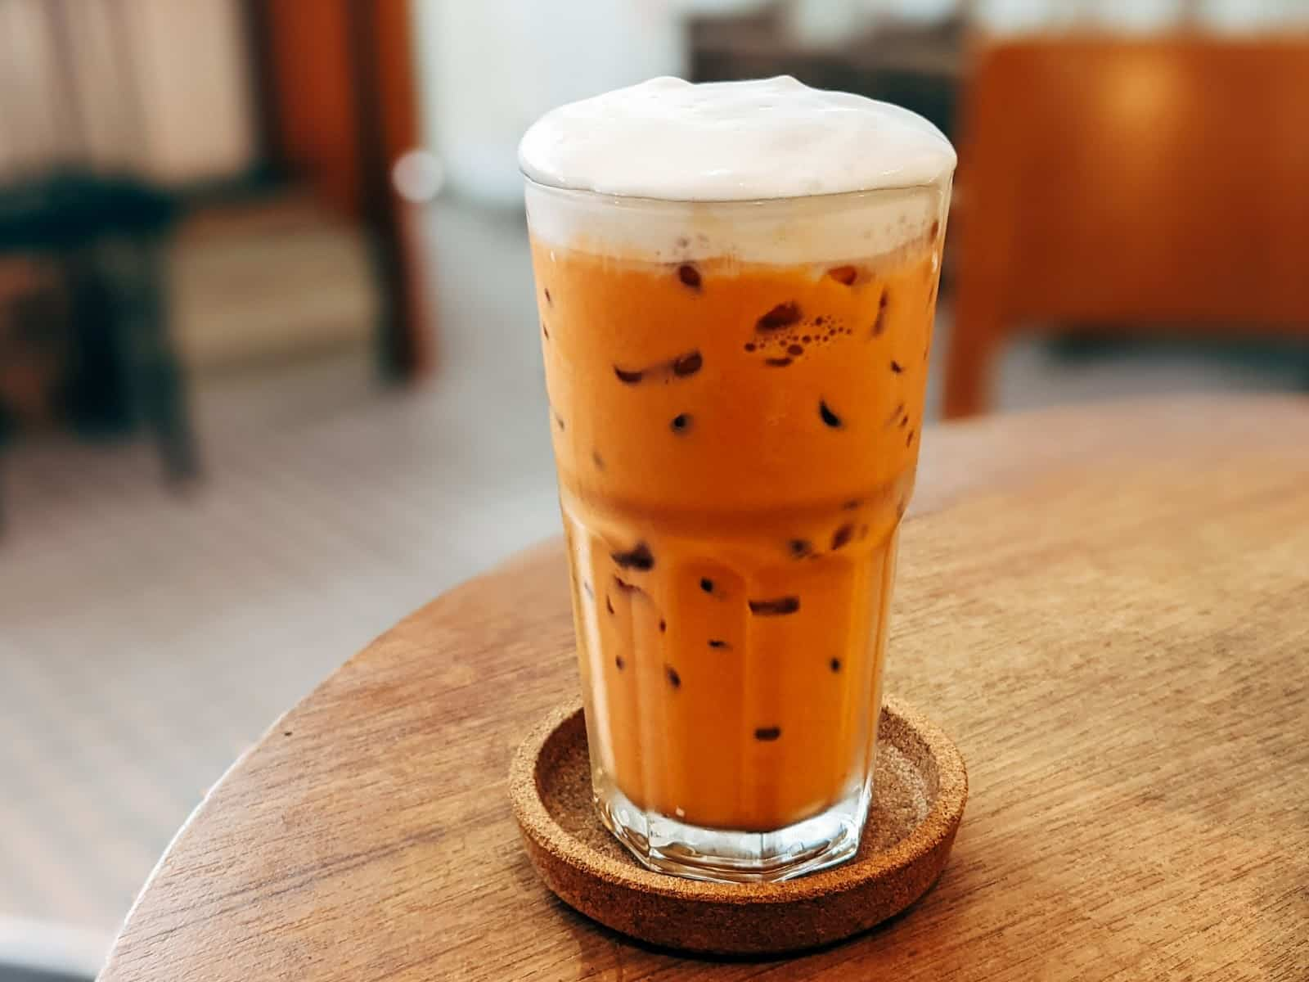
Market Basket Analysis
Pastry
Hot Arabica Coffee
Support = 0.16
Confidence = 0.69
Lift = 1.38
CO
FF
EE
Espresso
Support = 0.16
Confidence = 0.69
Lift = 1.42
Thai Tea
Support = 0.15
Confidence = 0.67
Lift = 1.32

Slide 30
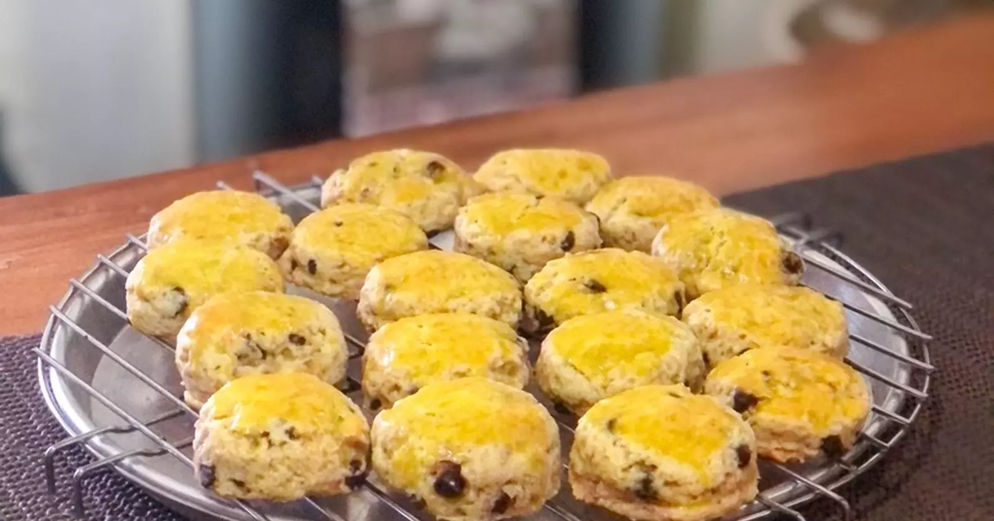
Market Basket Analysis
Scone Buah
Espresso
Support = 0.23
Confidence = 0.69
Lift = 1.41
CO
FF
EE
Hot Arabica Coffee
Support = 0.22
Confidence = 0.68
Lift = 1.35
Thai Tea
Support = 0.22
Confidence = 0.66
Lift = 1.31

Slide 31
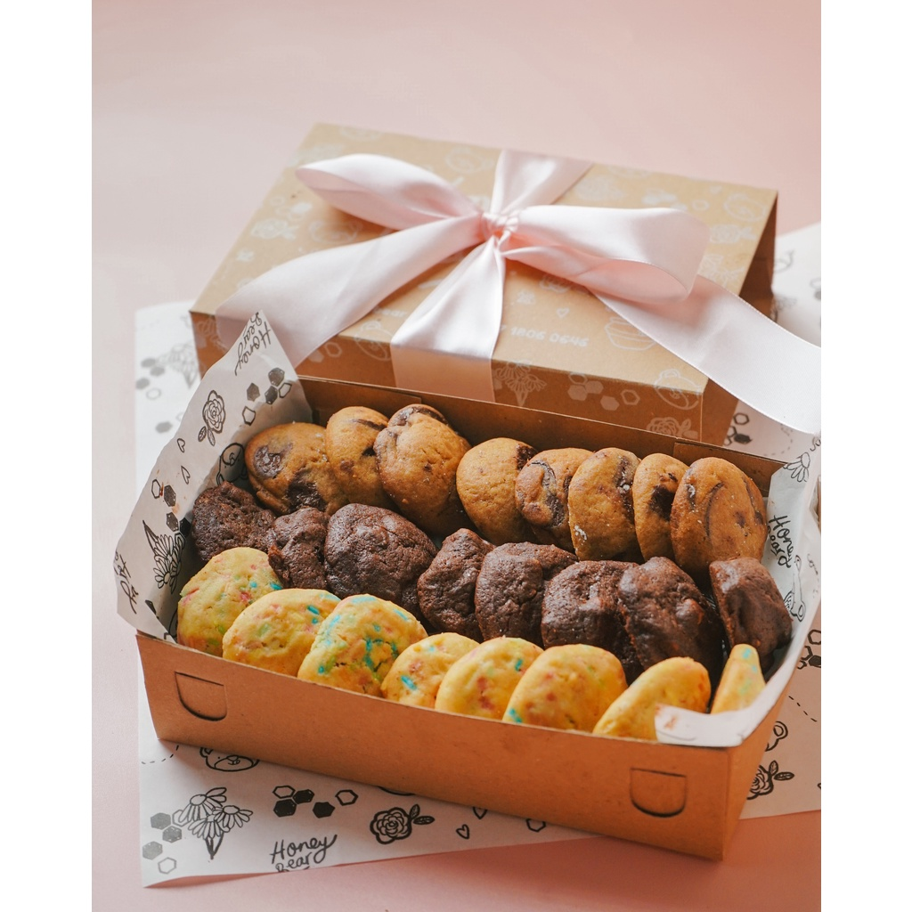
Market Basket Analysis
Cookies
Thai Tea
Support = 0.16
Confidence = 0.71
Lift = 1.41
CO
FF
EE
Hot Arabica Coffee
Support = 0.15
Confidence = 0.70
Lift = 1.40
Espresso
Support = 0.15
Confidence = 0.69
Lift = 1.40

Slide 32

THANK YOU

